Slide 1
LECTURE # 6
RELATIONS

Slide 2
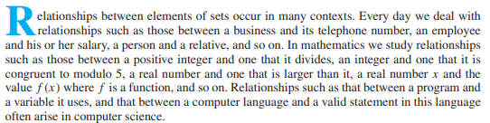

Relations & their Properties

Slide 3

Relations
Relationships between elements of sets are represented using the structure called a relation, which is just a subset of the Cartesian product of the sets.
It can be used to solve problems such as determining which pairs of cities are linked by airline ﬂights in a network.
ORDERED PAIRED
The most direct way to express a relationship between elements of two sets is to use ordered pairs made up of two related elements. For this reason, sets of ordered pairs are called binary relations.

Slide 4
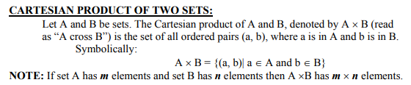
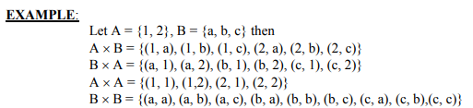

Slide 5
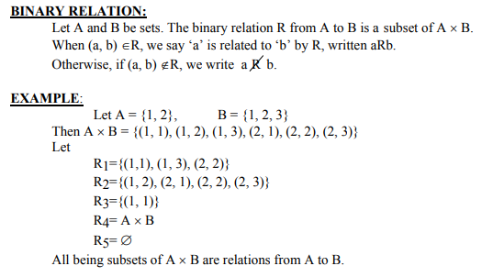
Subset of Cartesian product

Slide 6
Solution
Let A = {0, 1, 2} and B = {a, b}.
Then
{(0, a), (0, b), (1, a), (2, b)} is a relation from A to B. This means, for instance, that
x R y, but that not 1 R b. Relations can be represented graphically.
0 •
R a b
a
0
1
2
x x
x
x
1 •
b
2 •

Slide 7

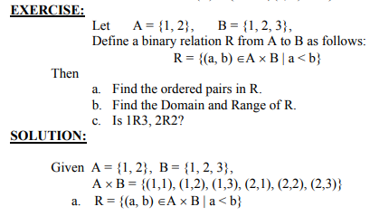


Slide 8
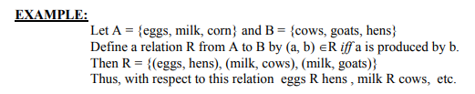
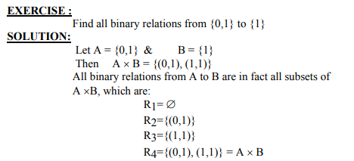

Slide 9
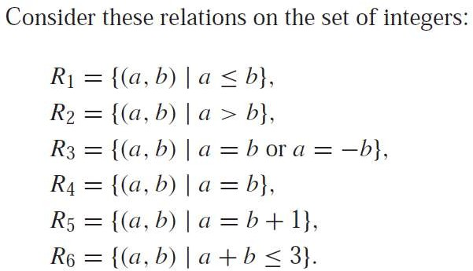
Example
Which of these relations contain each of the pairs (1, 1), (1, 2),
(2, 1), (1,−1), and (2, 2)?

Slide 10
Example
Which of these relations contain each of the pairs (1, 1), (1, 2),
(2, 1), (1,−1), and (2, 2)?
The pair
(1, 1) is in R₁, R₃, R₄, and R₆;
(1, 2) is in R₁ and R₆;
(2, 1) is in R₂, R₅, and R₆;
(1,−1) is in R₂, R₃, and R₆; and,
(2, 2) is in R₁, R₃, and R₄.

Slide 11
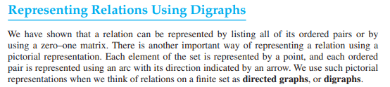
Representing Relations using Digraphs
Definition 1
A directed graph, or digraph, consists of a set V of vertices (or nodes) together with a set E of ordered pairs of elements of V called edges (or arcs). The vertex a is called the initial vertex of the edge (a, b), and the vertex b is called the terminal vertex of this edge.
An edge of the form (a, a) is represented using an arc from the vertex a
back to itself. Such an edge is called a loop.

Slide 12
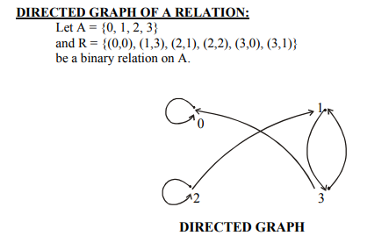
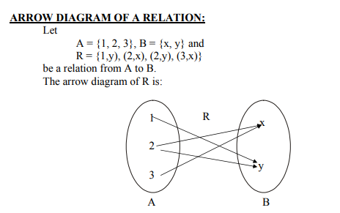

Slide 13
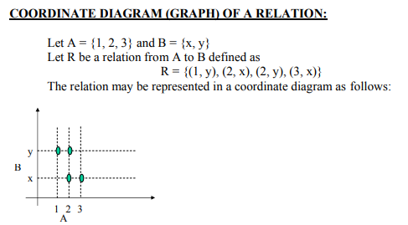

Slide 14
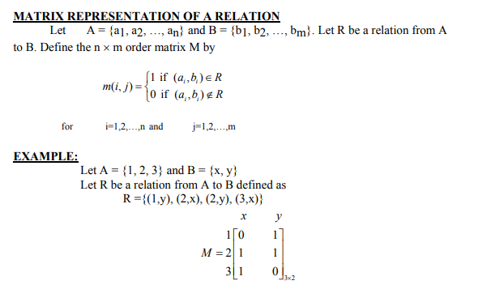

Slide 15
Union of Matrices
The matrix representing the union of two or more relations has a 1 in the positions where either M_{R1} or M_{R2} has a 1.
^{M}R₁ U R₂
= M_{R1} V M_{R2}
Intersection of Matrices
The matrix representing the intersection of two or more relations has a 1 in the positions where both M_{R1} and M_{R2} have a 1.
^{M}R₁ ∩ R₂
= M_{R1} ꓥ M_{R2}

Slide 16
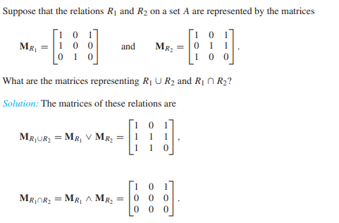
Practice question

Slide 17
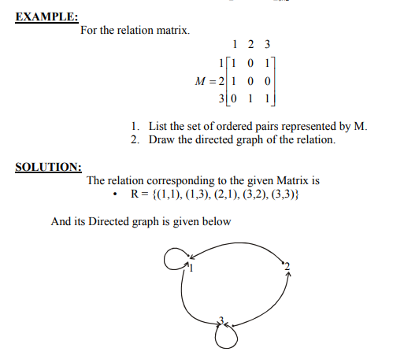

Slide 18
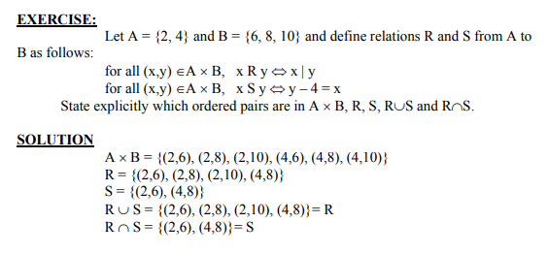

Slide 19


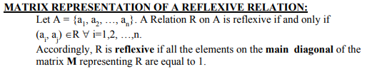

Slide 20
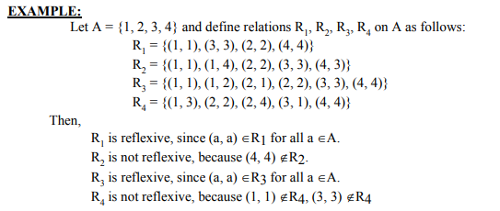
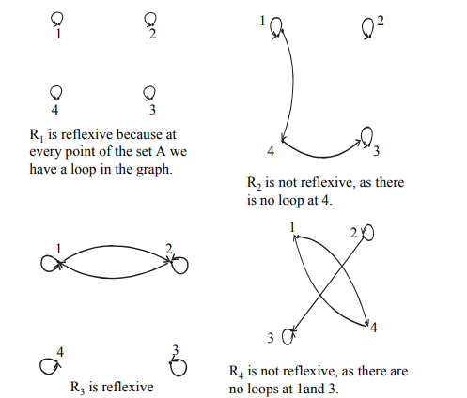

Slide 21
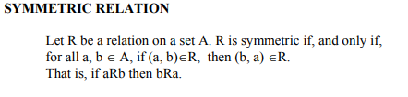
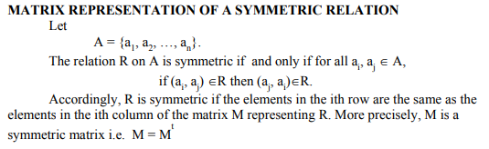
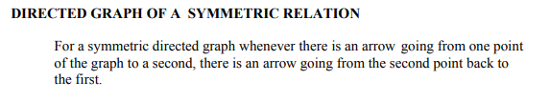

Slide 22
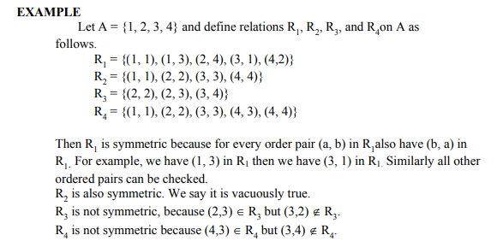
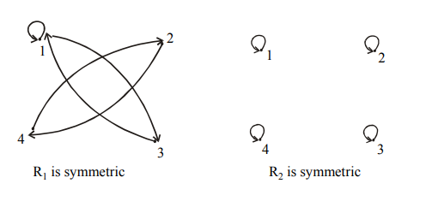
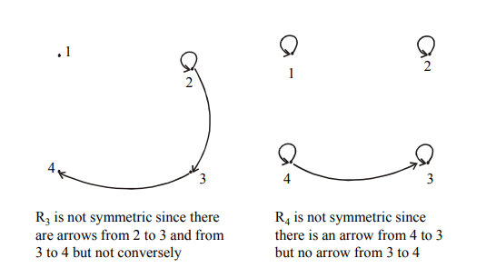

Slide 23
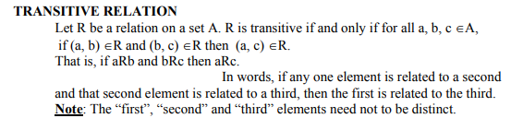

Slide 24
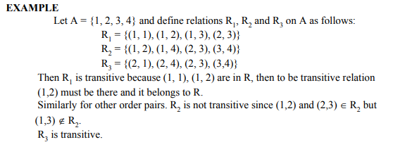
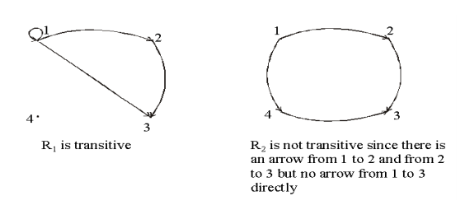
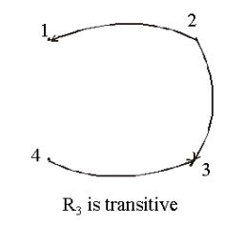

Slide 25



Slide 26


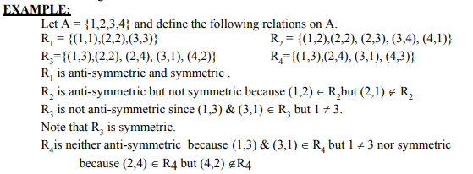

Slide 27
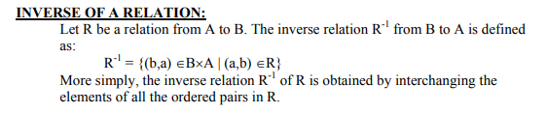
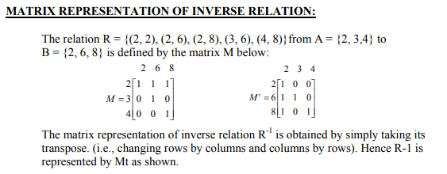

Slide 28


Slide 29
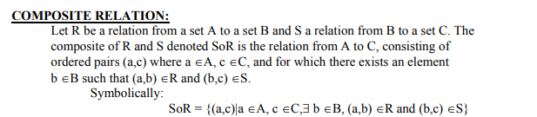

Slide 30
